Slide 1
CSS- Cascading style Sheet
CSS - Cascading Style Sheets allows authors and users to attach style (e.g., fonts, spacing,) to structured documents by separating content of documents and the presentation style of documents.
CSS simplifies site maintenance and Web authoring.

Slide 2
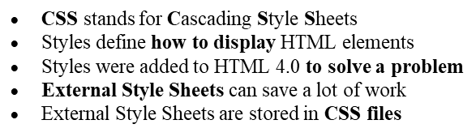
What is CSS?

Slide 3
About CSS
HTML was NEVER intended to contain tags for formatting a document.
HTML was intended to define the content of a document, like :
<h>
<p>
The style definitions are normally saved in css files.
With an external style sheet file, change the look of an entire Web site by changing a one file.

Slide 4
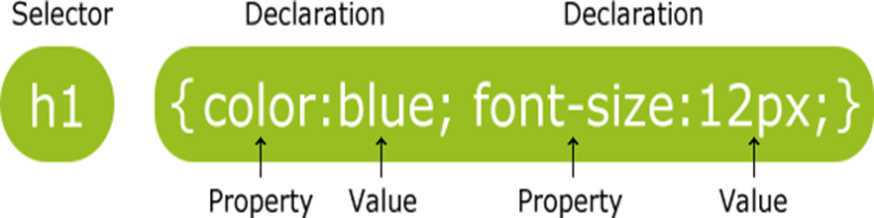

Slide 5
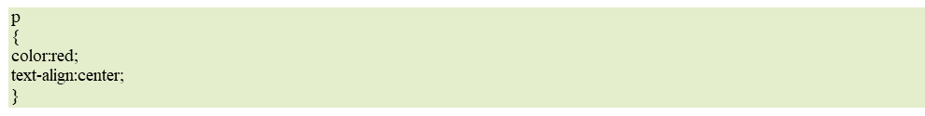
CSS Example
A CSS declaration always ends with a semicolon, and declaration groups are surrounded by curly brackets:
Example

Slide 6
CSS Selectors
CSS selectors are used to "find" (or select) the HTML elements you want to style.
We can divide CSS selectors into five categories:
Simple selectors (select elements based on name, id, class)
Combinator selectors (select elements based on a specific relationship between them)
Pseudo-class selectors (select elements based on a certain state)
Pseudo-elements selectors (select and style a part of an element)
Attribute selectors (select elements based on an attribute or attribute value)

Slide 7
The CSS element Selector
The element selector selects HTML elements based on the element name.
Example
Here, all <p> elements on the page will be center-aligned, with a red text color:
p { text-align: center; color: red; }

Slide 8
The CSS id Selector
The id selector uses the id attribute of an HTML element to select a specific element.
The id of an element is unique within a page, so the id selector is used to select one unique element!
To select an element with a specific id, write a hash (#) character, followed by the id of the element.
Example
The CSS rule below will be applied to the HTML element with id="para1":
#para1 { text-align: center; color: red; }

Slide 9
The CSS class Selector
The class selector selects HTML elements with a specific class attribute.
To select elements with a specific class, write a period (.) character, followed by the class name.
Example
In this example all HTML elements with class="center" will be red and center-aligned:
.center { text-align: center; color: red; }

Slide 10
The CSS Universal Selector
The universal selector (*) selects all HTML elements on the page.
Example
The CSS rule below will affect every HTML element on the page:
* { text-align: center; color: blue; }

Slide 11
The CSS Grouping Selector
The grouping selector selects all the HTML elements with the same style definitions.
Look at the following CSS code (the h1, h2, and p elements have the same style definitions):
h1 { text-align: center; color: red; } h2 { text-align: center; color: red; } p { text-align: center; color: red; }

Slide 12
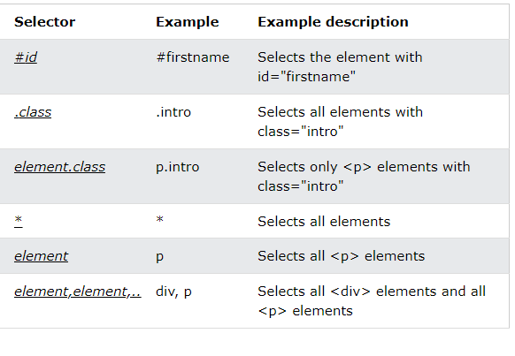
All CSS Simple Selectors

Slide 13
Contextual Selector in CSS
A contextual selector is defined as a selector which considers the context where the style is to be applied.
In simple words, the specified style is applied to an element only if the element is in the specified context.
Context can be defined as a parent/child relationship or ancestor/descendant relationship between different parts of the document.
A contextual selector is made up of two or more simple selectors separated by white space.
Class, any type, ID selector is considered as a simple selector.

Slide 14
Contextual Selector in CSS
Syntax:
div {color: red}
p {color: red;}
For any specific HTML element, we can apply the general CSS property that is required to style that element.
The below code example will illustrate the approach for applying the contextual selector.
In this, there is a parent div tag and its two-child p tags. The parent <p> tag and parent <div> tag turns the elements into red as the program executes.

Slide 15
<!DOCTYPE html>
<html>
<head>
<title>Contextual Selectors</title>
<style>
div {
color: red;
}
p {
color: red;
}
</style>
</head>
<body>
<div>
<p>Geeks For Geeks</p>
<p>A Computer Science portal for geeks.</p>
</div>
<p>What are Contextual Selectors in CSS?</p>
</body>
</html>

Slide 16
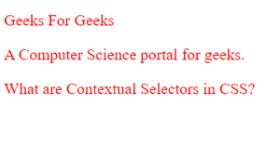
Output

Slide 17
Types of CSS (Cascading Style Sheet)
Cascading Style Sheet (CSS) is used to set the style in web pages that contain HTML elements. It sets the background color, font-size, font-family, color, etc. properties of elements on a web page.
There are three types of CSS which are given below:
Inline CSS
Internal or Embedded CSS
External CSS

Slide 18
Inline CSS
Inline CSS contains the CSS property in the body section attached to the element is known as inline CSS. This kind of style is specified within an HTML tag using the style attribute.
Example: This example shows the application of inline-css.

Slide 19
Example
<!DOCTYPE html>
<html>
<head>
<title>Inline CSS</title>
</head>
<body>
<p style="color:#009900; font-size:50px;
font-style:italic; text-align:center;">
GeeksForGeeks
</p>
</body>
</html>

Slide 20

Output

Slide 21
Internal or Embedded CSS
This can be used when a single HTML document must be styled uniquely.
The CSS rule set should be within the HTML file in the head section.
i.e. the CSS is embedded within the <style> tag inside the head section of the HTML file.

Slide 22
<!DOCTYPE html>
<html>
<head>
<title>Internal CSS</title>
<style>
.main {
text-align: center;
}
.GFG {
color: #009900;
font-size: 50px;
font-weight: bold;
}
.geeks {
font-style: bold;
font-size: 20px;
}
</style>
</head>
<body>
<div class="main">
<div class="GFG">GeeksForGeeks</div>
<div class="geeks">
A computer science portal for geeks
</div>
</div> </body> </html>

Slide 23

Output

Slide 24
External CSS
External CSS contains separate CSS files that contain only style properties with the help of tag attributes (For example class, id, heading, … etc).
CSS property is written in a separate file with a .css extension and should be linked to the HTML document using a link tag.
It means that, for each element, style can be set only once and will be applied across web pages.

Slide 25
Example
body {
background-color:powderblue;
}
.main {
text-align:center;
}
.GFG {
color:#009900;
font-size:50px;
font-weight:bold;
}
#geeks {
font-style:bold;
font-size:20px;
}

Slide 26
Below is the HTML file that is making use of the created external style sheet.
link tag is used to link the external style sheet with the html webpage.
href attribute is used to specify the location of the external style sheet file.

Slide 27
<!DOCTYPE html>
<html>
<head>
<link rel="stylesheet" href="geeks.css" />
</head>
<body>
<div class="main">
<div class="GFG">GeeksForGeeks</div>
<div id="geeks">
A computer science portal for geeks
</div>
</div>
</body>
</html>

Slide 28

Output

Slide 29
Priorities of CSS
Inline CSS has the highest priority, then comes Internal/Embedded followed by External CSS which has the least priority.
Multiple style sheets can be defined on one page. For an HTML tag, styles can be defined in multiple style types and follow the below order.
As Inline has the highest priority, any styles that are defined in the internal and external style sheets are overridden by Inline styles.
Internal or Embedded stands second in the priority list and overrides the styles in the external style sheet.
External style sheets have the least priority. If there are no styles defined either in inline or internal style sheet then external style sheet rules are applied for the HTML tags.

Slide 30
Style Specification Formats
The format of a style specification depends on the level of style sheet. Inline style specifications appearas values of the style attribute of a tag, isasfollows the general form is:
style="property_1:value_1;property_2:value_2;...; property_n:value_n;"

Slide 31
Style Specification Formats
The general form of the content of a style element is,
<styletype="text/css">
rule_list
</style>
The type attribute of the <style>tag tells the browser the type of style specification, which is text/css for CSS.

Slide 32
Style Specification Formats
Each style rule in a rule list has two parts:
a selector, which indicates the element or elements affected by the rule, and a list of property-value pairs.
The list has the same form as the quoted list for inline style sheets, except that it is delimited by braces rather than double quotes. So, the form of a style rule is as follows:
selector{property_1:value_1;property_2:value_2;...; property_n:value_n;}

Slide 33
Style Specification Formats
If a property is given more than one value, those values usually are separated with spaces.
For some properties, however, multiple values are separated with commas.
Like all other kinds of coding, complicated CSS rule lists should be documented with comments. Of course, HTML comments cannot be used here, because CSS is not HTML. Therefore, a different form of comment is needed.

Slide 34
Style Specification Formats
CSS comments are introduced with /* and terminated with */, as in the following element:
<style type="text/css">
/*Styles for the initial paragraph*/
...
/*Styles for other paragraphs*/
...
</style>
An external style sheet consists of a list of style rules of the same form as in document style sheets. The <style> tag is not included.

Slide 35
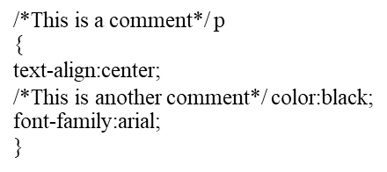
CSS Comments
Comments are used to explain your code, and may help you when you edit the source code at a later date.
Comments are ignored by browsers.
A CSS comment begins with "/*", and ends with "*/", like this:

Slide 36
Property Values forms
The used value of a CSS property is its value after all calculations have been performed on the computed value.
After the user agent has finished its calculations, every CSS property has a used value.
The used values of dimensions (e.g., width, line-height) are in pixels.
CSS values aren't just text; they come in different forms - URLs, units, measurements, integers, strings, inherit, auto, none, etc.
We will look at different CSS values and how to implement them.

Slide 37
Property Values forms
Value Description
initial Changes all the properties applied to
the element or the element's parent to
their initial value.
inherit Changes all the properties applied to the
element or the element's parent to their
parent value.
unset Changes all the properties applied to the
element or the element's parent to their
parent value if they are inheritable or to
their initial value if not.

Slide 38
Properties in CSS
Four common properties to work in CSS, ie.,
List properties
list-style, list-image, list-type
Font properties
Font, font-weight, font-style
Border properties
Border, border-color, border-radius, border-style, border-image
Text properties
Color, text-transform, text-align, letter-spacing, text-decoration

Slide 39
Font Properties
The font properties are among the most commonly used of the style-sheet properties.
Virtually All HTML Documents Include text, Which is often used in a variety of different situations.
This creates a need for text in many different fonts, font styles, and sizes.
The font properties allow us to specify these different forms.

Slide 40
Font Properties
The font property is a shorthand property for:
font-style
font-variant
font-weight
font-size/line-height
font-family
The font-size and font-family values are required. If one of the other values is missing, their default value are used.

Slide 41
Default value
The default value of the font properties are,
Inherited:yes
Animatable:yes, see individual properties.
Version:CSS1
JavaScript syntax:object.style.font="italic small-caps bold 12px arial,sans-serif"

Slide 42
CSS Syntax
font:
font-style
font-variant
font-weight
font-size/line-height
font-family|caption|icon|menu|message-box|small-caption|status-bar|initial|inherit;

Slide 43
Property Values
Property/Value Description
font-style Specifies the font style. Default value is "normal"
font-variant Specifies the font variant. Default value is "normal"
font-weight Specifies the font weight. Default value is "normal"
font-size/line-height Specifies the font size and the line-height. Default value
is "normal"
font-family Specifies the font family. Default value depends on the browser
caption Uses the font that are used by captioned controls (like buttons,
drop-downs, etc.)
icon Uses the font that are used by icon labels
menu Uses the fonts that are used by dropdown menus
message-box Uses the fonts that are used by dialog boxes
small-caption A smaller version of the caption font
status-bar Uses the fonts that are used by the status bar
initial Sets this property to its default value. Read about initial
inherit Inherits this property from its parent element. Read about inherit

Slide 44
Example
A demonstration of some of the other font property values.
<p style="font:caption">The browser font used in captioned controls.</p>
<p style="font:icon">The browser font used in icon labels.</p>
<p style="font:menu">The browser font used in dropdown menus.</p>
<p style="font:message-box">The browser font used in dialog boxes.</p>
<p style="font:small-caption">A smaller version of the caption font.</p>
<p style="font:status-bar">The browser font used in the status bar.</p>

Slide 45
Font Style
The font-style property is mostly used to specify italic text.
This property has three values:
normal - The text is shown normally
italic - The text is shown in italics
oblique - The text is "leaning" (oblique is very similar to italic, but less supported)

Slide 46
Example
p.normal { font-style: normal; } p.italic { font-style: italic; } p.oblique { font-style: oblique; }

Slide 47
Font Variant
The font-variant property specifies whether or not a text should be displayed in a small-caps font.
In a small-caps font, all lowercase letters are converted to uppercase letters. However, the converted uppercase letters appears in a smaller font size than the original uppercase letters in the text.
Example
p.normal { font-variant: normal; } p.small { font-variant: small-caps; }

Slide 48
Font Weight
The font-weight property specifies the weight of a font:
Example
p.normal { font-weight: normal; } p.thick { font-weight: bold; }
Value Common weight name
500 Medium
600 Semi Bold (Demi Bold)
700 Bold
800 Extra Bold (Ultra Bold)

Slide 49
Font Size
The font-size property sets the size of the text.
Being able to manage the text size is important in web design. However, you should not use font size adjustments to make paragraphs look like headings, or headings look like paragraphs.
Always use the proper HTML tags, like <h1> - <h6> for headings and <p> for paragraphs.
The font-size value can be an absolute, or relative size.
Absolute size:
Sets the text to a specified size
Does not allow a user to change the text size in all browsers
Absolute size is useful when the physical size of the output is known

Slide 50
Set Font Size With Pixels
Relative size:
Sets the size relative to surrounding elements
Allows a user to change the text size in browsers
Note: If you do not specify a font size, the default size for normal text, like paragraphs, is 16px (16px=1em). em is a unit of measurement, relative to the size of the font
1em is equivalent to 16px , and 2em is equivalent to 32px
Setting the text size with pixels gives you full control over the text size:
Example
h1 { font-size: 40px; } h2 { font-size: 30px; } p { font-size: 14px; }

Slide 51
Generic Font Families
In CSS there are five generic font families:
Serif fonts have a small stroke at the edges of each letter. They create a sense of formality and elegance.
Sans-serif fonts have clean lines (no small strokes attached). They create a modern and minimalistic look.
Monospace fonts - here all the letters have the same fixed width. They create a mechanical look.
Cursive fonts imitate human handwriting.
Fantasy fonts are decorative/playful fonts.
All the different font names belong to one of the generic font families.

Slide 52
Font shorthand property
CSS Font Property:
A Shorthand Property, is a shortcut to giving values to other various CSS properties in one go.
The CSS font property is also a shorthand property for several other font related properties which are; font-style property. font-variant property.
CSS shorthand is a group of CSS properties that allow values of multiple properties to be set simultaneously.
These values are separated by spaces.
For example, the border property is shorthand for the border-width, border-style, and border-color properties.

Slide 53
CSS Text Decoration
The text-decoration shorthand CSS property sets the appearance of decorative lines on text.
It is a shorthand for,
text-decoration-line ,
text-decoration-color ,
text-decoration-style , and the newer
text-decoration-thickness property.
text-decoration property takes underline, overline, line-through, underline overline values to decorate the text in different ways.
The text-decoration property is used to “decorate” the content of the text.

Slide 54
Properties
All CSS text-decoration Properties
Property Description
text-decoration-color Specifies the color of
the text-decoration
text-decoration-line Specifies the kind of
text decoration to be used
(underline, overline, etc.)
text-decoration-style Specifies the style of the
text decoration (solid,
dotted, etc.)

Slide 55
Add a Decoration Line to Text
The text-decoration-line property is used to add a decoration line to text.
Tip: You can combine more than one value, like overline and underline to display lines both over and under a text.
Example
h1 { text-decoration-line: overline; } h2 { text-decoration-line: line-through; } h3 { text-decoration-line: underline; } p { text-decoration-line: overline underline; }

Slide 56
Text-decoration-color property
The text-decoration-color property is used to set the color of the decoration line.
Example
h1 { text-decoration-line: overline; text-decoration-color: red; }
Specify a Style for the Decoration Line :
The text-decoration-style property is used to set the style of the decoration line.
Example
h1 { text-decoration-line: underline; text-decoration-style: solid; }

Slide 57
Text-decoration-thickness property
Specify the Thickness for the Decoration Line
The text-decoration-thickness property is used to set the thickness of the decoration line.
Example
h1 { text-decoration-line: underline; text-decoration-thickness: auto; }

Slide 58
Text Spacing
The letter-spacing CSS property sets the horizontal spacing behavior between text characters.
This value is added to the natural spacing between characters while rendering the text (the process of converting a string to a format that is readable to the user).
Browsers by default will create a certain amount of space between lines to ensure that the text is easily readable.
For example, for 12-point type, a browser will place about 1 point of vertical space between lines.

Slide 59
Text Spacing
Property Description
letter-spacing Specifies the space between
characters in a text
line-height Specifies the line height
text-indent Specifies the indentation of the
first line in a text-block
white-space Specifies how to handle white-
space inside an element
word-spacing Specifies the space between
words in a text

Slide 60
List Properties
In HTML, there are two main types of lists:
unordered lists (<ul>) : the list items are marked with bullets
ordered lists (<ol>) : the list items are marked with numbers or letters
The CSS list properties allow you to:
Set different list item markers for ordered lists
Set different list item markers for unordered lists
Set an image as the list item marker
Add background colors to lists and list items

Slide 61
List Properties
list-style-type (if a list-style-image is specified, the value of this property will be displayed if the image for some reason cannot be displayed)
list-style-position (specifies whether the list-item markers should appear inside or outside the content flow)
list-style-image (specifies an image as the list item marker)

Slide 62
Example
Unordered Lists:
Coffee
Tea
Coca Cola
Ordered Lists:
Coffee
Tea
Coca Cola

Slide 63
Different List Item Markers
The list-style-type property specifies the type of list item marker.
The following example shows some of the available list item markers:
ul.a { list-style-type: circle; } ul.b { list-style-type: square; } ol.c { list-style-type: upper-roman; } ol.d { list-style-type: lower-alpha; }

Slide 64
Example of Image and Position
Image Download :
ul { list-style-image: url('sqpurple.gif'); }
Position The List Item Marker :
ul.a { list-style-position: outside; } ul.b { list-style-position: inside; }

Slide 65
Alignment of Text
properties:
text-align
text-align-last
direction
unicode-bidi
vertical-align

Slide 66
Text Alignment
The text-align property is used to set the horizontal alignment of a text.
A text can be left or right aligned, centered, or justified.
The following example shows center aligned, and left and right aligned text (left alignment is default if text direction is left-to-right, and right alignment is default if text direction is right-to-left):

Slide 67
Example
h1 { text-align: center; } h2 { text-align: left; } h3 { text-align: right; }
When the text-align property is set to "justify", each line is stretched so that every line has equal width, and the left and right margins are straight (like in magazines and newspapers).
div {
text-align: justify;
}

Slide 68
Text Direction
The direction and unicode-bidi properties can be used to change the text direction of an element:
Example
p { direction: rtl; unicode-bidi: bidi-override; }

Slide 69
Vertical Alignment
The vertical-align property sets the vertical alignment of an element.
Example
Set the vertical alignment of an image in a text:
img.a { vertical-align: baseline; } img.b { vertical-align: text-top; } img.c { vertical-align: text-bottom; } img.d { vertical-align: sub; } img.e { vertical-align: super; }

Slide 70
The CSS Text Alignment/Direction Properties
Properties
Property Description
direction Specifies the text direction/writing
direction
text-align Specifies the horizontal alignment of text
text-align-last Specifies how to align the last line of a text
unicode-bidi Used together with the direction property to
set or return whether the text should be
overridden to support multiple
languages in the same document
vertical-align Sets the vertical alignment of an element

Slide 71
Color
The color property is used to set the color of the text. The color is specified by:
a color name - like "red"
a HEX value - like "#ff0000"
an RGB value - like "rgb(255,0,0)“
The default text color for a page is defined in the body selector.
Example
body { color: blue; } h1 { color: green; }

Slide 72
Color Groups & Color Properties
In this example, we define both the background-color property and the color property:
Example
body { background-color: lightgrey; color: blue; } h1 { background-color: black; color: white; } div { background-color: blue; color: white; }

Slide 73
The Box Model
All HTML elements can be considered as boxes.
The CSS Box Model :
In CSS, the term "box model" is used when talking about design and layout.
The CSS box model is essentially a box that wraps around every HTML element.
It consists of:
margins, borders, padding, and the actual content. The image below illustrates the box model:

Slide 74
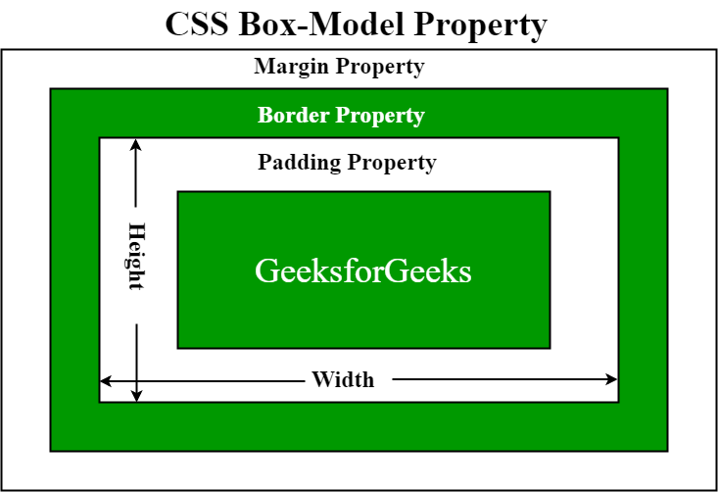
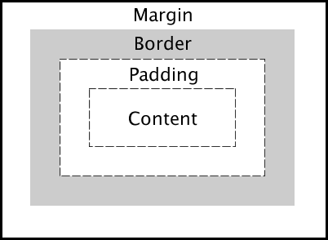
CSS Box Model

Slide 75
CSS Box Model
Explanation of the different parts:
Content - The content of the box, where text and images appear
Padding - Clears an area around the content. The padding is transparent
Border - A border that goes around the padding and content
Margin - Clears an area outside the border. The margin is transparent
The box model allows us to add a border around elements, and to define space between elements.

Slide 76
Example
Demonstration of the box model:
div { width: 300px; border: 15px solid green; padding: 50px; margin: 20px; }

Slide 77
CSS Border Style
The border-style property specifies what kind of border to display.
The following values are allowed:
dotted - Defines a dotted border
dashed - Defines a dashed border
solid - Defines a solid border
double - Defines a double border
groove - Defines a 3D grooved border. The effect depends on the
border-color value
ridge - Defines a 3D ridged border. The effect depends on the
border-color value
inset - Defines a 3D inset border. The effect depends on the border-
color value
outset - Defines a 3D outset border. The effect depends on the
border-color value
none - Defines no border
hidden - Defines a hidden border

Slide 78
Example
Demonstration of the different border styles:
p.dotted {border-style: dotted;} p.dashed {border-style: dashed;} p.solid {border-style: solid;} p.double {border-style: double;} p.groove {border-style: groove;} p.ridge {border-style: ridge;} p.inset {border-style: inset;} p.outset {border-style: outset;} p.none {border-style: none;} p.hidden {border-style: hidden;} p.mix {border-style: dotted dashed solid double;}

Slide 79
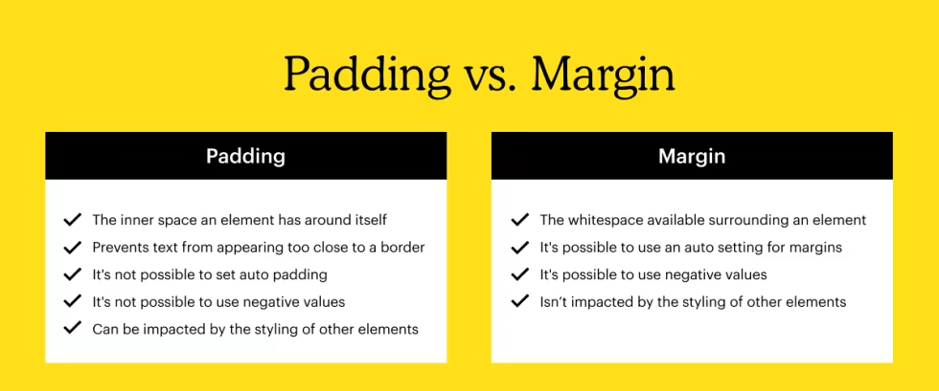

Slide 80
Background Images
The background-image property sets one or more background images for an element.
By default, a background-image is placed at the top-left corner of an element, and repeated both vertically and horizontally.
Tip: The background of an element is the total size of the element, including padding and border (but not the margin).

Slide 81
Example
Set a background-image for the <body> element:
body { background-image: url("paper.gif"); background-color: #cccccc; }

Slide 82

Example

Slide 83
The <span> and <div> Tags
A div element is used for block-level organization and styling of page elements, whereas a span element is used for inline organization and styling.
Example
A <span> element which is used to color a part of a text:
<p>My mother has <span style="color:blue">blue</span> eyes.</p>

Slide 84
<div> tag
The <div> tag defines a division or a section in an HTML document.
The <div> tag is used as a container for HTML elements - which is then styled with CSS or manipulated with JavaScript.
The <div> tag is easily styled by using the class or id attribute.

Slide 85
<html> <head> <style> .myDiv { border: 5px outset red; background-color: lightblue; text-align: center; } </style> </head> <body> <div class="myDiv"> <h2>This is a heading in a div element</h2> <p>This is some text in a div element.</p> </div> </body> </html>

Slide 86
The <span> tag is an inline container used to mark up a part of a text, or a part of a document.
The <span> tag is easily styled by CSS or manipulated with JavaScript using the class or id attribute.
The <span> tag is much like the <div> element, but <div> is a block-level element and <span> is an inline element.

Slide 87
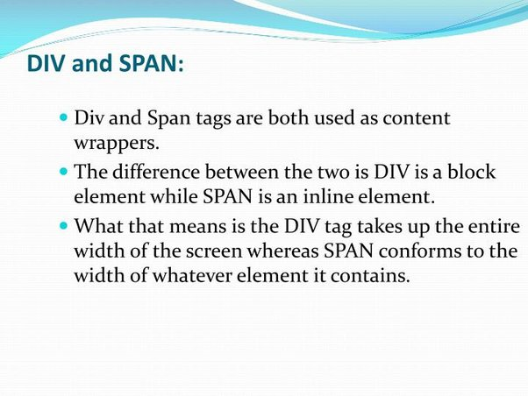

Slide 88
Conflict Resolution
Conflict resolution—This term may denote the circumstance that after a conflict resolution no conflict exists any longer between related elements.
The conflict may be seen in the fact that, e.g., two CSS definitions may exist at the same time, but only one may be used at a point in time.

Slide 89
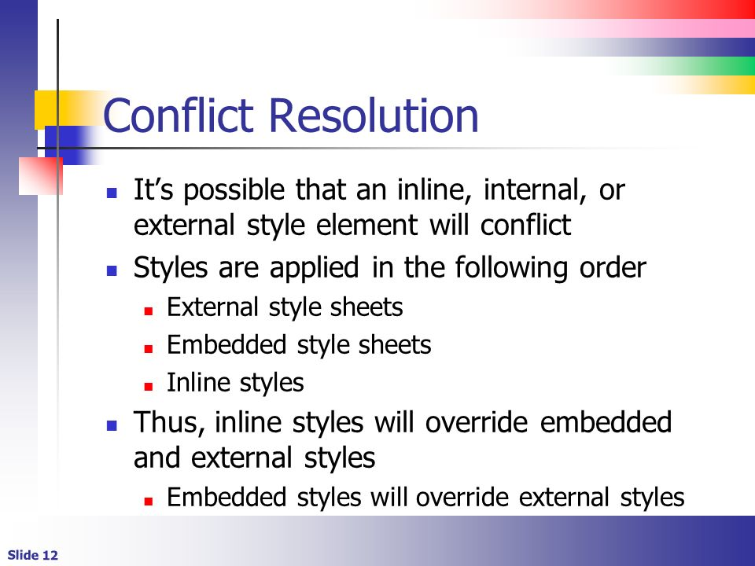

Slide 90
